Slide 1
Biocom CRO Presents: Concept to Commercial: A Clinical and Regulatory Outlook
October 11, 2017

Slide 2
Hello Mr. CEO – Here is what I think you need to know
Therapeutics Inc.
The Dermatology CRO

Slide 3
Agenda
TI overview
B – school 101
Planning
Gap Management
Transition Point Navigation
Serving your Constituency
Notes:
3
3

Slide 4
Therapeutics, Inc. - The Dermatology CRO
A Fully Integrated CRO from Concept → FDA Approval
Turn-Key Product Development: Program Management, Formulation, CMC, Non-Clinical, Clinical, Regulatory Affairs
All Categories: Drugs, Devices, Biologics
All Dosage Forms: Topical, Oral, Injectable
Dermatology Focus (~85%) / Other (~15%)
Development Focus
Not Discovery; Not Sales & Marketing
Recent Five Years
Filed > 15 IND/IDEs
Conducted >90 studies in >10,000 subjects
Multiple product approvals
Headcount: ῀75
Founded: 1997

Slide 5
B School 101
Business
Selling the concept ; raising capital
TEAM just as important as the technology – Diversity is key
Selective use of KOL’s at early stage
Be clear on business case objectives – but not rigid
Focus on the short-term priorities and milestones (Critical path)
Set the culture norms early and re-inforce frequently
Don’t forget to pause and reflect
Notes:
5

Slide 6
Planning – Many paths to failure, few to success
Have specialized planning / tracking / PM staff
Use tools (ie MS Project) as direction – setting, milestone tracking, and communication
Manageable plans ; beware of thousand-line MS schedules
Contingencies – development of ‘what – if’ scenarios
Update plan as frequently as needed
My two rules
Take no small slips
Underspent = behind schedule (most of the time)
Define processes for transitions
Notes:
6

Slide 7
Mind the Gap(s)
‘Jack of all trades’ expertise is essential
Formal transition (stage-gate) reviews
What is missing? What is superfluous?
Call options for next stage and beyond
Seek out alternate points of view
Treat all functional disciplines with equal care and concern
It really does take a team
Notes:
7

Slide 8
Transition Point Essentials
Express the last phase data, and full program data in easy-to-interpret form
Define clearly your next phase objectives
Early Kill strategy vs one pony scenario
If moving ahead, what is needed, when, and who is to deliver?
View your program data objectively. Define best, likely, and worst case risk scenarios.
Evaluate the data. Get consensus. Take measured risks where appropriate.
Remember products are like children. They have their own personality. Continually revise your expectations and objectives in light of this fact.
Notes:
8

Slide 9
Serving Multiple Masters
Investors, Regulators, Commercialization partners, etc all view your data and project differently (in most cases)
Balancing is an art form, not a science.
Its OK to be uncertain. That’s the nature of this business.
Failure is a reality. But it does not have to be fatal.
Shoot for early small successes to build momentum. More games are won on base hits than grand slams.
Be clear, proactive, and collaborative with FDA.
Clinical studies answer one question well if properly designed and executed.
Notes:
9

Slide 10
Questions?
Thank You for your time this morning
Notes:
10

Slide 11
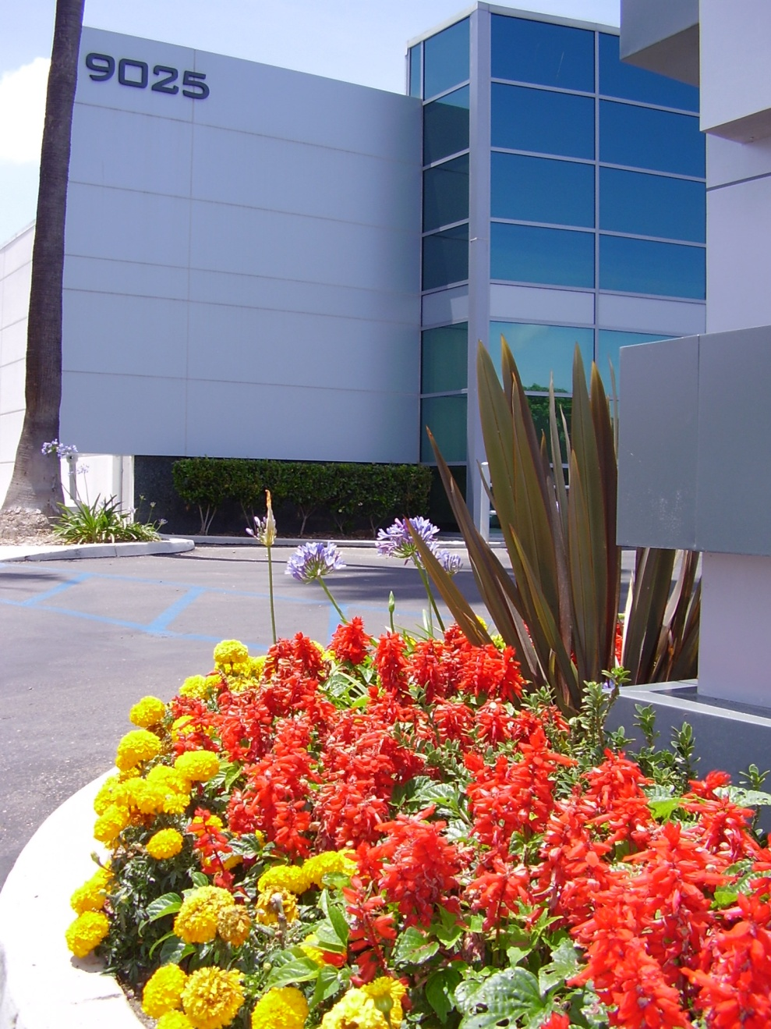
Therapeutics Incorporated 9025 Balboa Avenue, Suite 100 San Diego, CA 92123 Office: 858-571-1800, x152 Fax: 858-571-1234
www.therapeuticsinc.com
Notes:
11
11

