Slide 1
Considerations for Successful Biopharmaceutical Product Development: Discovery to Proof of Concept
-A Panel Discussion
Stanley C. McDermott, PharmD, MS, RPh
Managing Director – Regulatory Sciences
Head, Clinical Research / Clinical Affairs
Cardinal Health Regulatory Sciences

Slide 2
Session Objectives
Biopharmaceutical product development is a complex process, requiring extensive time and resources from sponsors and investors.
Key concepts to consider during the development and approval processes for new drugs;
  emphasis on how inventors and entrepreneurs can minimize the time to confirm clinical proof of concept (PoC)
Better understanding of how to simplify this highly interesting, yet complicated process.

Slide 3



Expertise and credentials
Industry- and FDA-trained experts providing regulatory science and product development consulting services required for product approval and product lifecycle management
120+ NDA/BLA/ANDA approvals supported
500+ INDs supported
500+ approved products under maintenance (100+ countries)
40
800+
170+
Years of global experience
Clients served
Regulatory scientists
in-house

Slide 4

Core service areas
Global regulatory development consulting
Chemistry, manufacturing and controls
Clinical development and research
Medical
writing
Nonclinical
development
Regulatory competencies and offerings
Compliance
Regulatory publishing
Launch and post-approval
Licensing and registrations
Training

Slide 5
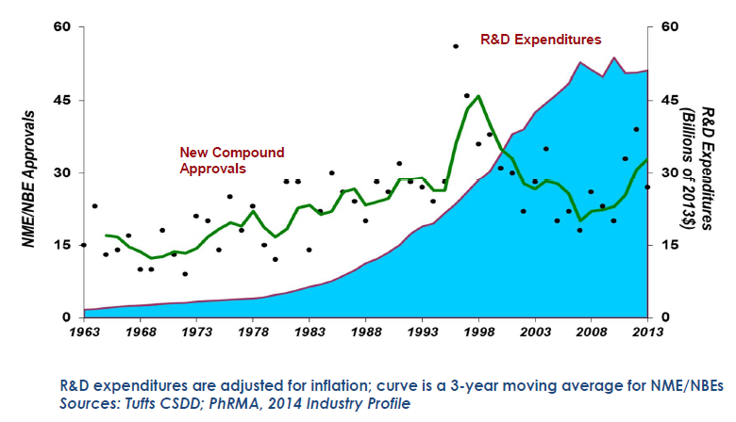
New Drug and Biologics Approvals and Research and Development Spending
Joseph A. DiMasi. Cost of Developing a New Drug [Briefing]. Tufts University Center for Drug Development. Nov 18, 2014. http://csdd.tufts.edu/files/uploads/Tufts_CSDD_briefing_on_RD_cost_study_-_Nov_18,_2014..pdf, http://csdd.tufts.edu/news/complete_story/cost_study_press_event_webcast

Slide 6
The New Drug Development Process
Pre-Clinical
Research
Clinical Studies
NDA
Review
E
Phase 1
Industry Time
E
Phase 2
Synthesis and
Purification
Phase 3
FDA Time
Animal Testing
Accelerated Development/Review
E
Early Access:
Subpart E
E
Treatment IND
Short-Term
Parallel Track
Sponsor/FDA
Meetings
Encouraged
Long-Term
Institutional
Review Boards
Advisory
Committees
IND
Submitted
NDA
Submitted
Review
Decision
Sponsor answers
any questions
from review
Effective use to accelerated PoC
http://www.fda.gov/Drugs/DevelopmentApprovalProcess/SmallBusinessAssistance/ucm053131.htm

Slide 7



Mapping Product Development Stages
Target selection &
validation
Discovery
Development
Studies of
Disease Mechanisms
Target
receptor; ion channel; transporter;
enzyme; signalling molecule
Drug Candidate
safety testing
  Lead Search
-Develop assays (use of automation)
-Chemical diversity
-Highly iterative process
Human Studies
Phases I,II, III
Molecular Studies
Animal Studies
- relevant species
- transgenic KO/KI mice
- conditional KOs
- agonists/antagonists
- antibodies
- antisense
- RNAi
Lead optimization
-selectivity
-efficacy in animal models
-tolerability: AEs mechanism-
based or structure-based?
-pharmacokinetics
-highly iterative process
Drug Approval
and Registration

Slide 8
Target Selection & Validation
Define the unmet medical need (disease)
Understand the molecular mechanism of the disease
Identify a therapeutic target in that pathway (e.g. gene, key enzyme, receptor, ion-channel, nuclear receptor)
Demonstrate that target is relevant to disease mechanism using genetics, animal models, lead compounds, antibodies, RNAi, etc.

Slide 9
Discovery through Nonclinical Development
Develop an assay to evaluate activity of compounds on the target
- in vitro (e.g. enzyme assay)
- in vivo (animal model or pharmacodynamic assay)
Identify a lead compound
  screen collection of compounds (“compound library”)
  compound from published literature
  screen Natural Products
  structure-based design (“rational drug design”)
Optimize to give a “proof-of-concept” molecule—one that shows efficacy in an animal disease model
Optimize to give drug-like properties—pharmacokinetics, metabolism, off-target activities
Safety assessment, Preclinical Candidate!!!

Slide 10
Drug Product Design
Selection Criteria for Dosage Forms
  Clinical Needs
  Dose/Onset/Duration of Action
  Product Performance
  Patient Compliance/Acceptance
  Marketing Considerations

Slide 11
Discovery to Nonclinical - Convergence of Disciplines
Synthetic
Chemistry
Patent Law
Combinatorial
Chemistry
Modelling
Novel Molecule
Intellectual Property
Physiology
Information
Technology
Design
Structural Activity
Biochemistry
Physiology
Safety
Pharmacodynamics
Physiology
Metabolism
Pharmacology
Safety
Assessment
Immunology
In Vivo activity
Pharmacokinetic
Properties
DMPK
Pharmacology
Behavior
Physiology
Physical
Chemistry
Pathology
Physiology
Enzymology

Slide 12
Clinical Development
Submit Investigational New Drug (IND) Application
  Provides exemption from a federal statute
  Effective in 30 days if FDA does not object or request additional information
Phase 1 Clinical Trials
  Approximately 1 year in duration
  Requires 20 to 80 subjects
  Assess the safety profile, pharmacokinetic (PK) characteristics, and safe dosage range (SAD, MAD, MTD studies)*
  Evaluate absorption, distribution, metabolism and excretion (ADME studies), and the duration of presence/action
*Single ascending dose (SAD), Multiple ascending dose (MAD), Maximum tolerated dose (MTD)
Modified based on information obtained from: www.fda.gov

Slide 13
Clinical Development
Phase 2 Clinical Trials
  Approximately 2 years in duration
  Controlled studies composed of 100 to 300 patients
  Dose ranging in the target patient population
  Assess safety and efficacy of dosing and formulation variances
Phase 3 Clinical Trials
  Approximately 3 years in duration
  Requires 300 to 3,000 or more patients (intended use population)
  Compare new therapies with existing standard of care and assess safety and efficacy of final (commercial) formulation product
Modified based on information obtained from: www.fda.gov

Slide 14
Developmental Clinical Pharmacology:
Emphasis on PoC
Typically short, involving relatively few HVs/patients
  FIH (SAD/MAD; with one patient cohort)
  Phase 1 Biomarker
  PK/PD
Intelligent Go/No-Go endpoints
  Proof of Mechanism
  Proof of Efficacy
Generally lack statistical significance
High quality read-outs (PD, biomarker, etc..)
  Clinical physiology
  Adaptive designs

Slide 15
Discussion

